Slide 1


Slide 2





Team details
TEAM NAME: 20981A4960
AKHIL (Team Leader) College:Stream: Year of graduation: 2024 DINESH College: Stream: Year of graduation: 2024 |  | TEJA College: Stream: Year of graduation: 2024
RAGHU ENGINEERING COLLEGE
RAGHU ENGINEERING COLLEGE
Computer Science
Computer Science
CHARAN
^{Photo}
College:
RAGHU ENGINEERING COLLEGE
RAGHU ENGINEERING COLLEGE
Stream:
Computer Science
Computer Science
Year of graduation: 2024

Slide 3
Describing the problem statement:
Ocean pollution, particularly the accumulation of microplastics and floating debris, poses a grave threat to marine ecosystems and the environment at large. These pollutants not only harm marine life but also disrupt delicate ecosystems and enter the food chain, potentially affecting human health. Traditional cleanup methods are labor-intensive, costly, and often unable to effectively target small-scale pollutants like microplastics
Microplastic pollution is a major problem in the ocean. Microplastics are small pieces of plastic that are less than
5 millimeters in size. They can be found in all parts of the ocean, from the surface to the deep sea. Microplastics
can harm marine life, and they can also enter the human food chain.
The ocean is a huge body of saltwater that covers about 71 percent of Earth’s surface. The planet has one global ocean, though oceanographers and the countries of the world have traditionally divided it into four distinct regions: the Pacific, Atlantic, Indian, and Arctic oceans. Beginning in the 20th century, some oceanographers labeled the
seas around Antarctica the Southern Ocean, and in 2021 National Geographic officially recognized this fifth ocean.

Slide 4
Proposed solution:
Project Title: Autonomous Microplastic Collector in Ocean
The goal of this project is to design and prototype an autonomous device that can effectively collect microplastics and other floating debris from ocean surfaces. The device should be energy-efficient, capable of autonomous navigation, and have a scalable design to cover large areas of the ocean.
An autonomous microplastic collector could be used to clean up microplastic pollution in the ocean. The collector would need to be able to:
Navigate autonomously in the ocean
Collect microplastics from the water column
Dispose of the microplastics in a safe and environmentally friendly way
The development of an autonomous microplastic collector is a complex engineering challenge, but it is a challenge that is worth pursuing. With continued research and development, it is possible to develop a collector that can make a significant impact on the fight against microplastic pollution.

Slide 5
How does my innovation accelerate change with the power of Technology?
Accelerating Change with Technology Innovation
The Power of Technology in Ocean Cleanup
In the face of escalating ocean pollution and microplastic contamination, our innovation, the Autonomous Microplastic Collector, harnesses the full potential of technology to drive substantial and lasting change. With a focus on cutting-edge engineering and sustainability, our project leverages technological advancements to address the critical issue of marine pollution in a proactive and efficient manner.
Transforming Ocean Cleanup: A Technological Leap
1. Precision Navigation and Autonomous Operation
Our collector integrates advanced navigation algorithms and sensory systems, enabling it to autonomously traverse even the most challenging ocean conditions. This level of precision empowers the collector to cover vast areas efficiently, targeting microplastics and debris with unparalleled accuracy.
2. Efficient Debris Collection Mechanisms
Through innovative design, our technology incorporates state-of-the-art collection mechanisms that effectively capture microplastics and floating debris from the ocean's surface. By optimizing filtration methods and materials, our solution minimizes the risk of false positives while maximizing debris collection.
3. Renewable Energy Integration
Technology empowers sustainability. We integrate renewable energy sources, such as solar panels and wind turbines, into our collector's framework. This ensures consistent operation while drastically reducing the ecological footprint of our cleanup efforts.
4. Real-time Monitoring and Data Insights
Our technological innovation isn't just about collection—it's about insight. Our collector features real-time monitoring and data collection capabilities that provide invaluable information about ocean conditions, pollution levels, and environmental impact. This data empowers informed decision-making and continuous optimization.

Slide 6
How is my solution different/unique from other solutions in market
The successful completion of this project will result in a functional prototype of the autonomous microplastic collector. The prototype should demonstrate its ability to autonomously navigate, effectively collect microplastics, and operate sustainably using renewable energy sources. A comprehensive report detailing the design, development process, test results, and potential environmental impact assessment will also be produced.
Impact: The project's impact lies in its contribution to mitigating the widespread problem of ocean pollution. By creating a cutting-edge solution for microplastic and debris collection, the project aims to preserve marine ecosystems, protect wildlife, and improve the overall health of our oceans. Additionally, the project has the potential to inspire further innovations in the field of ocean cleanup technologies and sustainable engineering solutions.
PATENT FILED: No
Do you have a working model/prototype: No
If not, will you be able to show working prototype during finale. Yes

Slide 7
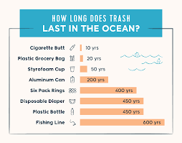
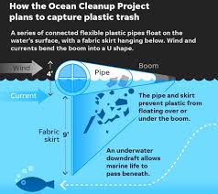
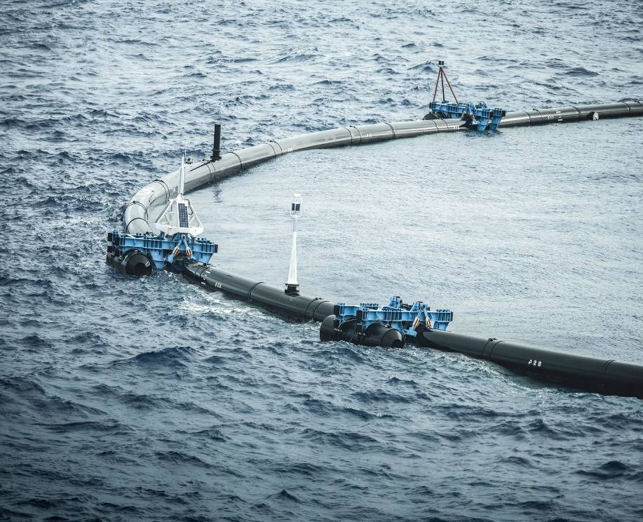
testimonials received?
TILL NOW NOT RECEIVED
Relevant Images:

Slide 8


Thank you!

